Slide 1

Student Services Presents: The College Application Process
Fall 2024
Mr. Curtis, Ms. Dallam, Mrs. Evans, Ms. Lillo, Mrs. Meacham, and Mrs. Rodriguez

Slide 2
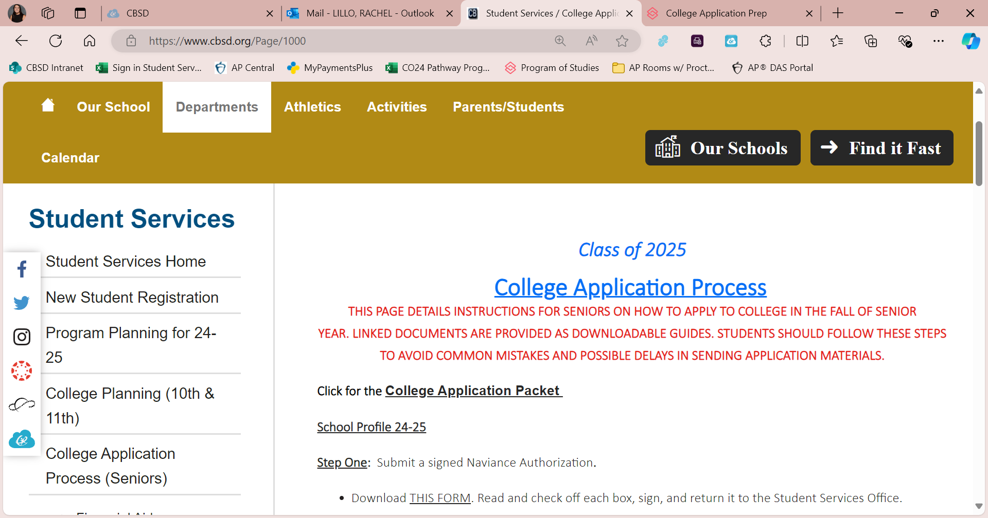
ALL information is on the Student Services WEBSITE, and in the COLLEGE PACKET.
We’ve printed the packet for you and put it in a bright YELLOW FOLDER. Free. No charge. Don’t lose it ☺

Slide 3
Steps for Applying to College
STEP ONE
STEP TWO
STEP THREE
Request your Transcripts through Naviance
STEP FOUR
Request Teacher Letters of Rec through Naviance / see Teachers IN PERSON
STEP FIVE
Send SAT/ACT scores through College Board / ACT websites (if required)
Turn in a Transcript Authorization form / submit Counselor Survey in Naviance
Complete College Applications (use "Common App" or college website/app)

Slide 4
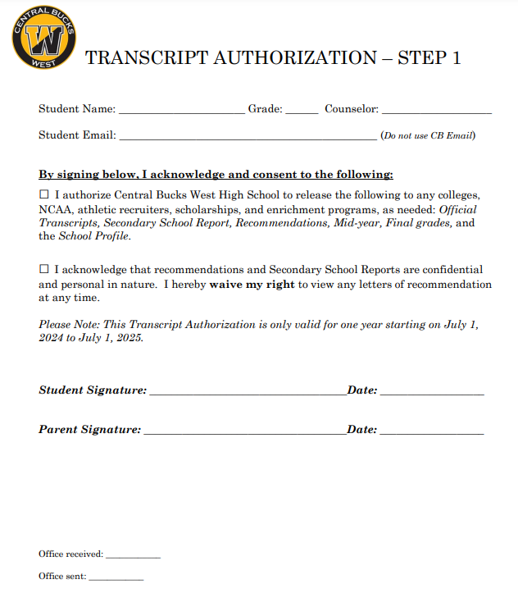
STEP 1:
Submit Transcript Authorization form to Student Services
This permits us to send your records to colleges and universities.
Parent/Guardian signature required if you’re under 18.
If your school requires a counselor letter, fill out the Counselor Rec Survey in Naviance.
  (About Me --> Surveys from Your School).
Once received, we will activate the Transcript Portal in Naviance, so you can request transcripts and teacher LOR on/after Tuesday, Sept 10th.

Slide 5
Counselor Recommendations
You do NOT request Counselor letter through Naviance like you do for teachers.
Complete the Counselor Recommendation Survey in Naviance
  (About Me > Surveys from Your School)
  We recommend that all students complete the survey because you may need one for a future application or scholarship. It's 10 questions- you can do this!
Make sure this survey is completed prior to requesting transcripts. If not, this will delay submission of your materials.
If you are applying to a college that requires Counselor letters of recommendation, we will write/send one after you request transcripts.

Slide 6
STEP 2: Complete College Applications
The Common Application
Most schools accept the Common Application, including Penn State.
Create a Common App account at www.commonapp.org.
Other ways of applying
College’s website / individual application.
The college website will direct you towards any alternative ways to apply.

Slide 7
Check Application Requirements!
On the college’s website you should find a section listing everything you must include in your application.
This is usually under “Freshman Admissions” or “First-Year Applicants.”
Friendly notice: admissions offices may be scanning for AI generated essays- you have been warned!

Slide 8
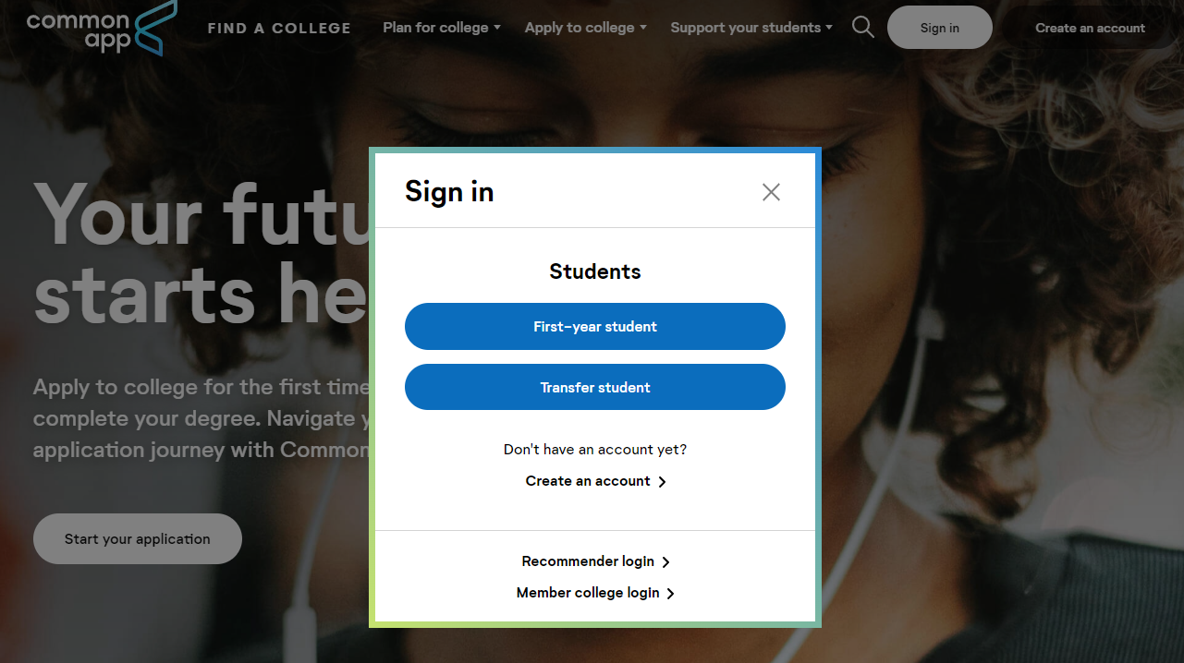
Filling out the Common App
(www.Commonapp.org)

Slide 9
Why do we need to follow step-by-step instructions?
You need to complete your FERPA WAIVER and MATCH your Common App with Naviance.
We cannot send school application documents without this.
Common App won’t let you complete the FERPA WAIVER and MATCH until some basic information is completed in your PROFILE and EDUCATION sections.

Slide 10
KEY STEPS in starting to fill out the Common App
(pics to follow . . .)
COMMON APP tabs:
Fill out Profile first (name, address, etc.)
Fill out High School details on the Education Tab.
After that, you’ll be able to do your FERPA Waiver.
Finally, “Match” Common App and Naviance accounts.
Return to finish other sections of the Common App later.

Slide 11
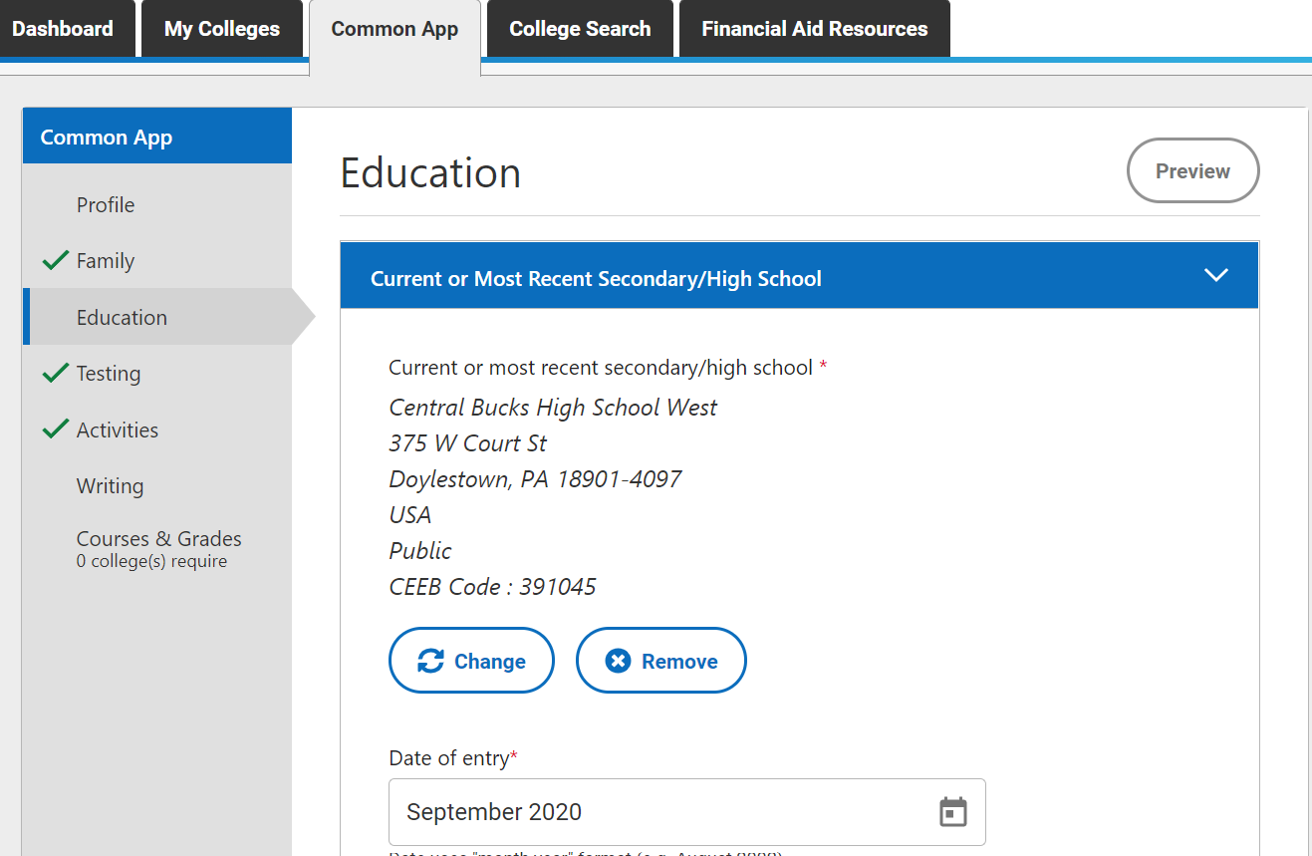
Complete the Education Tab:
Enter your High School info.
If you went to a CB middle school:
List your 9th grade classes under “CB West” with your other courses.
You can’t add/select Lenape or Tohickon.
If you transferred at any point to CB West:
Complete information for your former school(s) in addition to CB West.

Slide 12

You’ll need this info to complete the Education Tab. (It’s also available on website):
Copy of your high school Transcript (from your portal, under “Reports”).
Senior year schedule to input your classes.
Graduation date: June 13, 2025.
Your counselor’s name, email address, and phone number. Our “job title” is School Counselor.
Our class size is 469.
Class rank reporting: “None.”
Central Bucks SD doesn’t officially report rank.
GPA Scale: 4.0
GPA Weighting: Select “Weighted.”

Slide 13
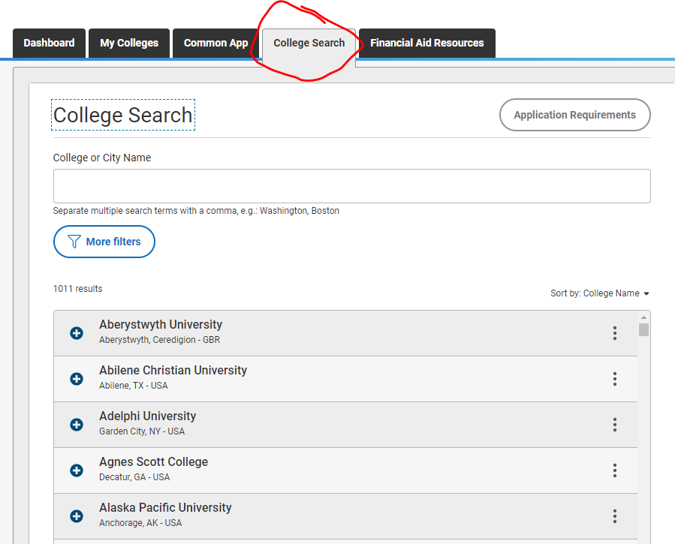
Add Colleges!
Click on COLLEGE SEARCH TAB to find and add colleges to your Common App list.

Slide 14
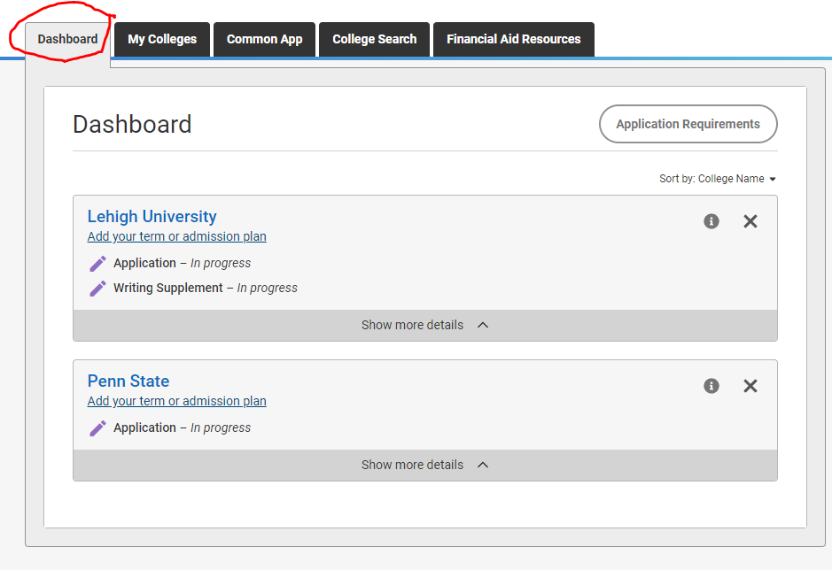
Use the DASHBOARD to track all your added schools.

Slide 15
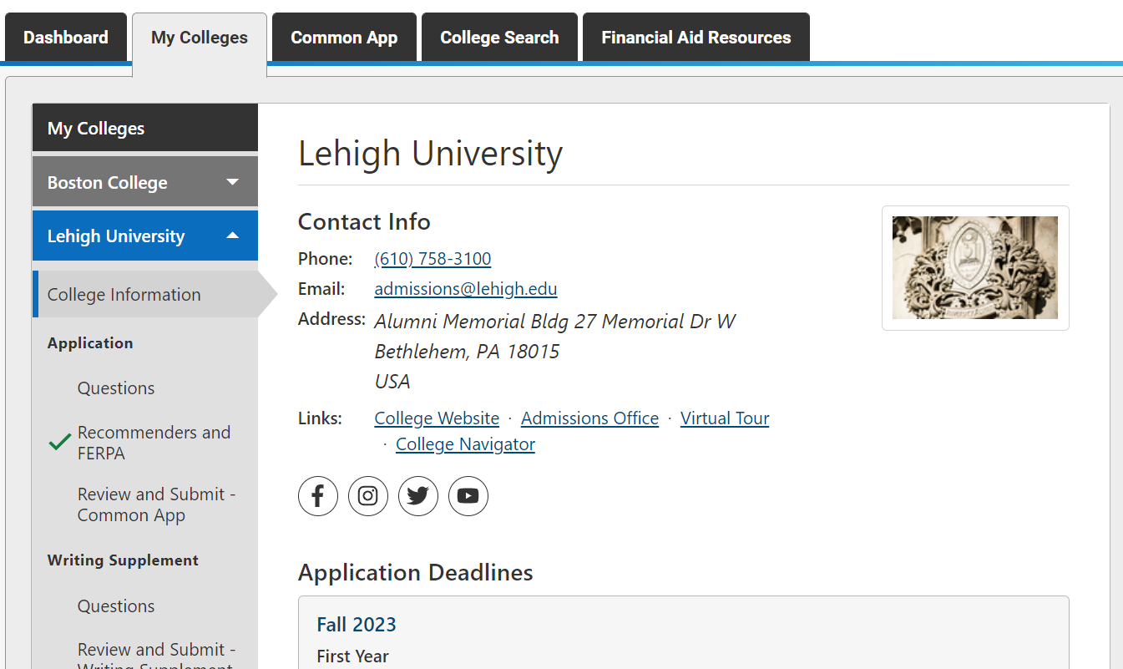
Complete FERPA Waiver
You need to waive your rights to see your application materials. You do this once, and it will apply to all schools. If you don’t do this, we can’t send your Common App/school documents.
FERPA Waiver
Click on any one of your listed colleges in My Colleges tab.
From the left panel, click on “Recommenders and FERPA.”

Slide 16
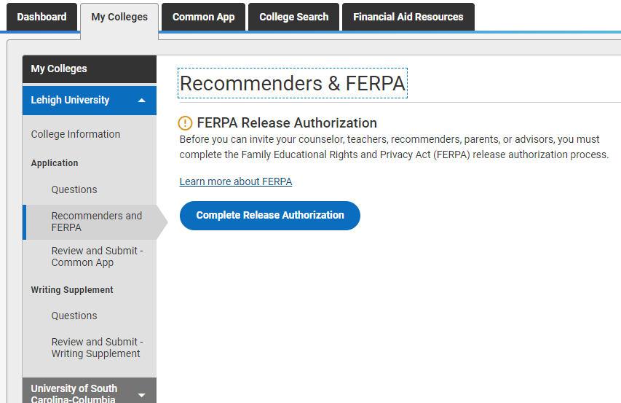
Follow instructions
You want to WAIVE ALL RIGHTS to review confidential letters of recommendation.
Waiving your rights reassures colleges that the letters will be candid and truthful.
Read all parts of the waiver and click indicated boxes.
Once you do this for one school, you do not need to do it again!

Slide 17
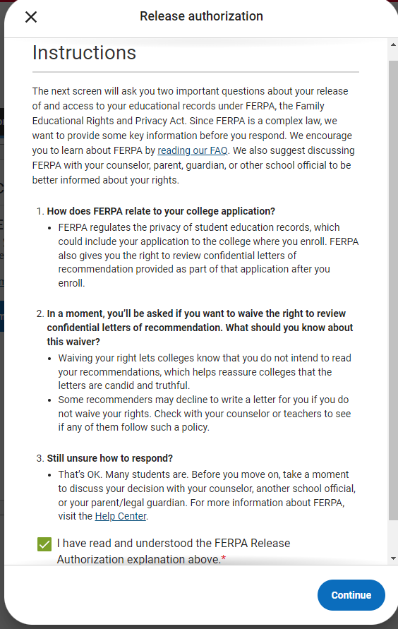
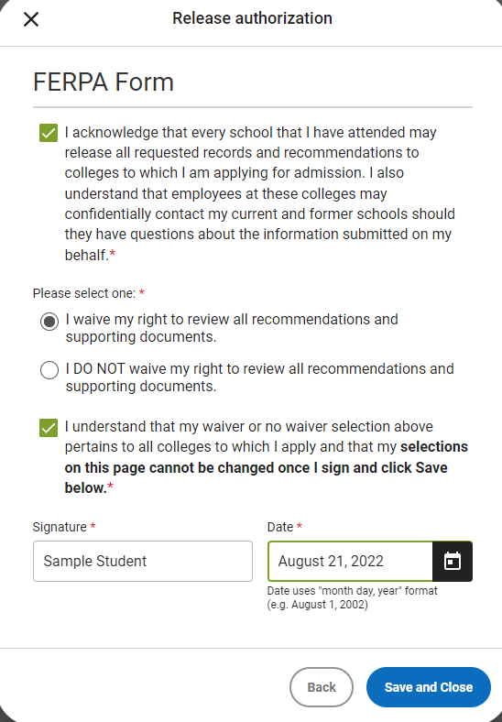

Slide 18
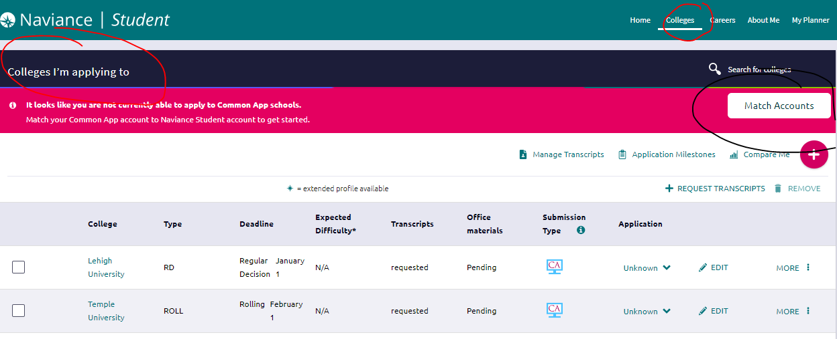
Next, MATCH your Naviance and Common App accounts.

Slide 19
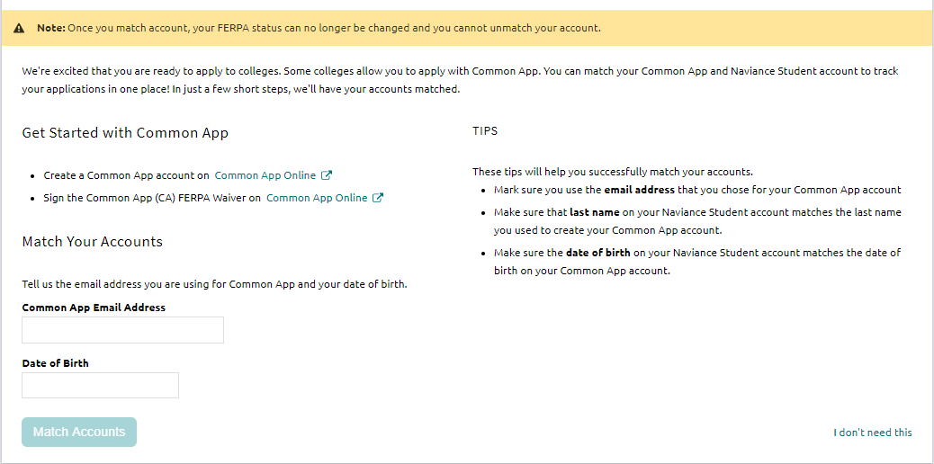
Just fill in your CA email address (NOT your CB email, and DOB, and click “Match Accounts.”
If you’re NOT using Common App for ANY application, click “I don’t need this”

Slide 20
STEP 3:
Request Transcripts through Naviance
…Opens Tuesday, September 10th
Transcripts are requested electronically through Naviance.
Transcripts should be sent after applications are substantially completed.
Your Transcript Authorization must have already been submitted. (See Step 1).

Slide 21
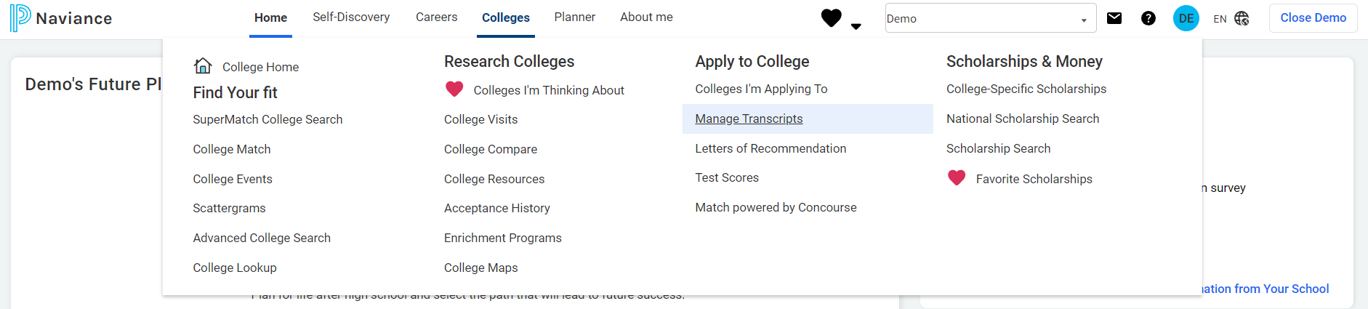
Go to the “Colleges” Tab
Select “Manage Transcripts”

Slide 22
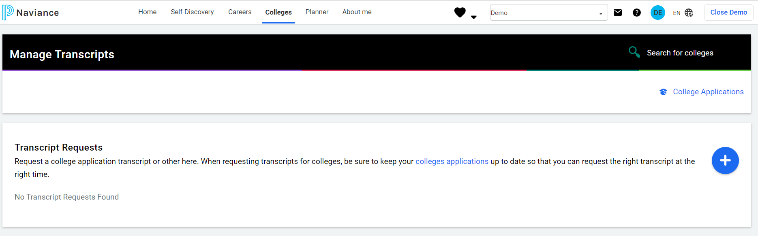
Then, click PLUS button to begin adding your requests for transcripts.
You will then go through multiple steps, answering questions about your application. . . .

Slide 23
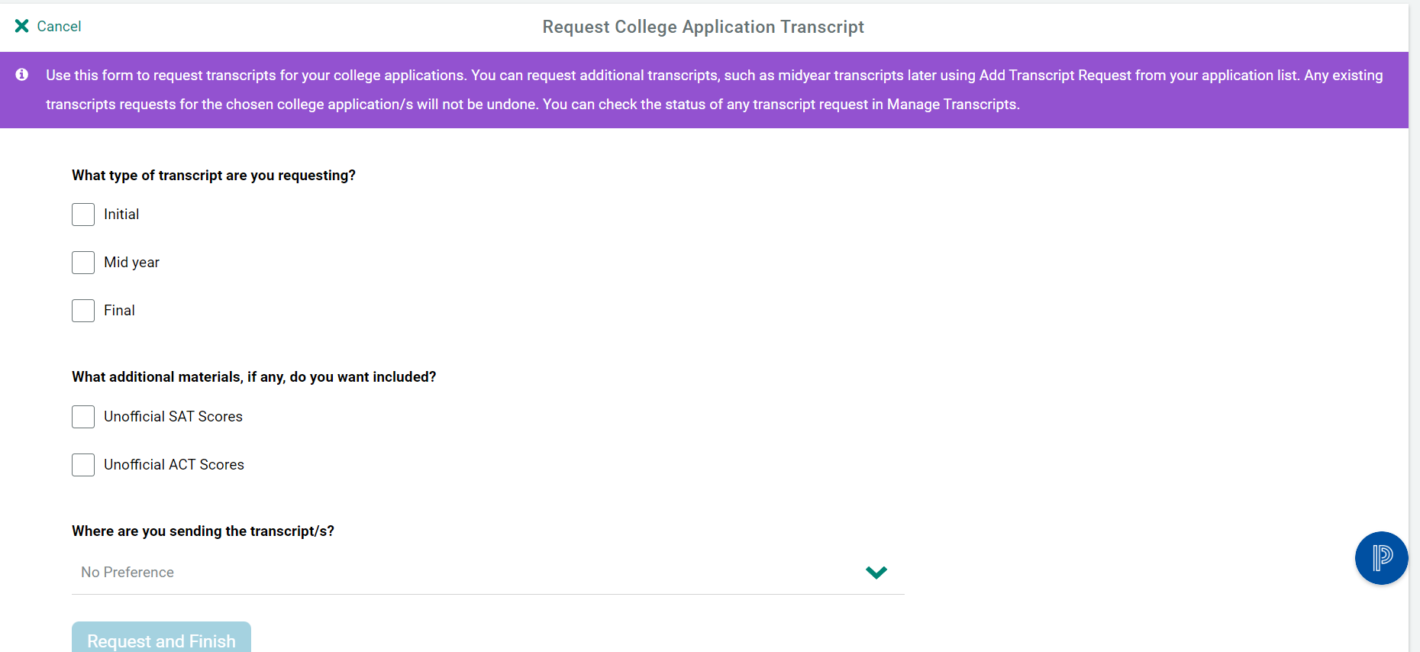

Slide 24
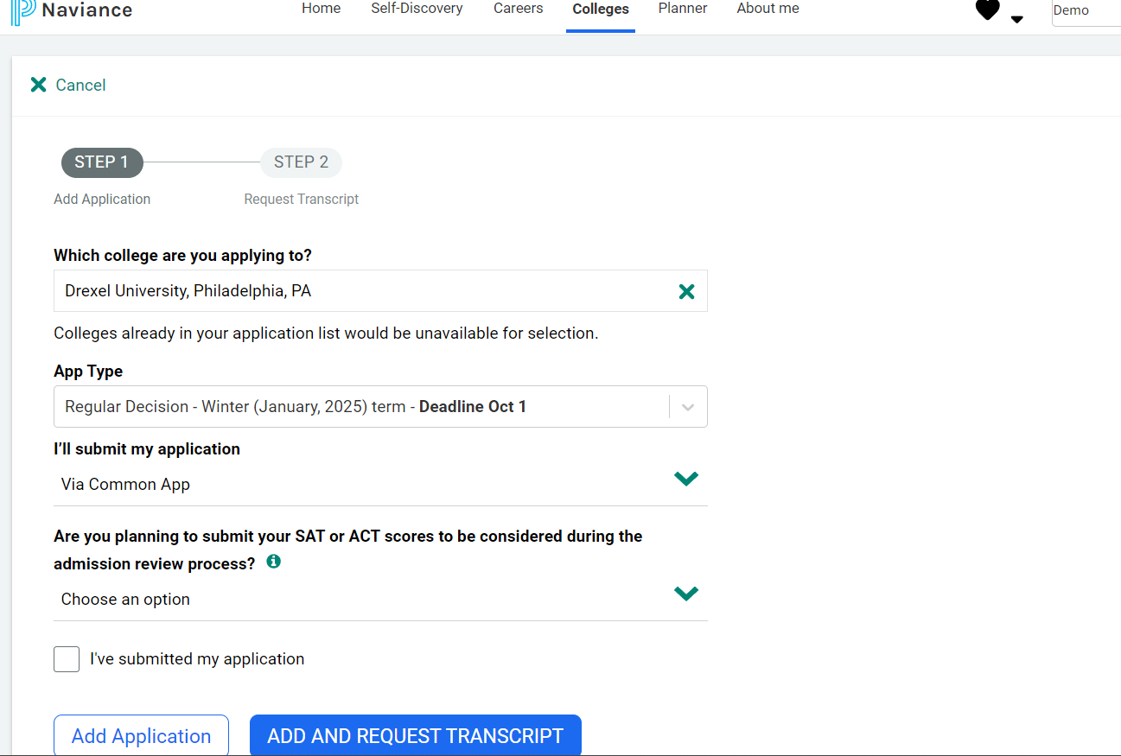

Slide 25
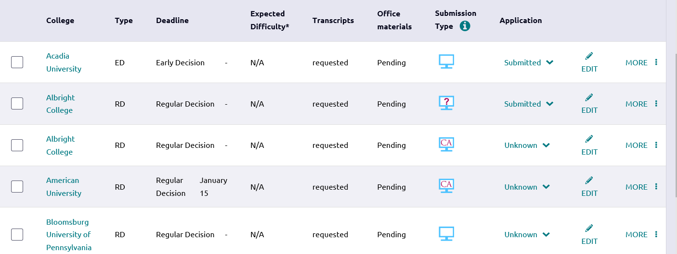
If a question mark is in the screen, then you are missing something. You must click edit and make sure you pick the correct submission type: Common App or Directly to the Institution
  If you are applying through Common App, PLEASE make sure you have Common App listed as your submission type.

Slide 26
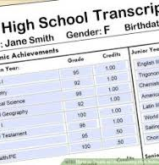
SRAR
(Self-Reported Academic Record)
You have access to your unofficial transcript in the Student Portal, this will help you complete your SRAR​.
Many colleges REQUIRE that you complete this step after submission of your application.
  If you do not submit this, your application will be deemed incomplete! ​
After submitting your application, you will be sent portal information for every college.
  Check these portals, they will tell you what you are missing!

Slide 27
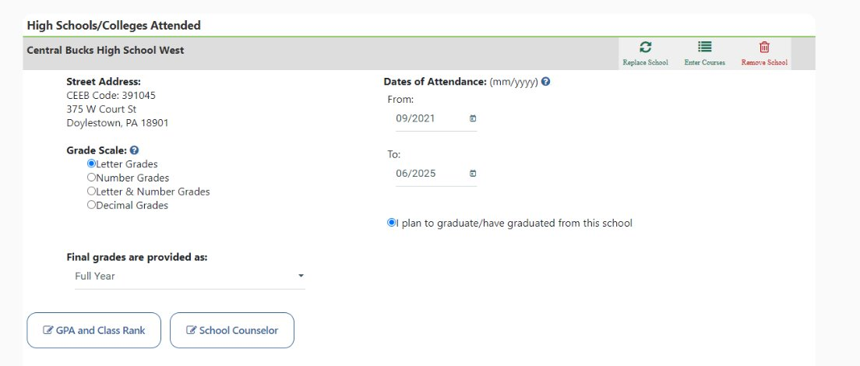
SRAR
(Self-Reported Academic Record)

Slide 28
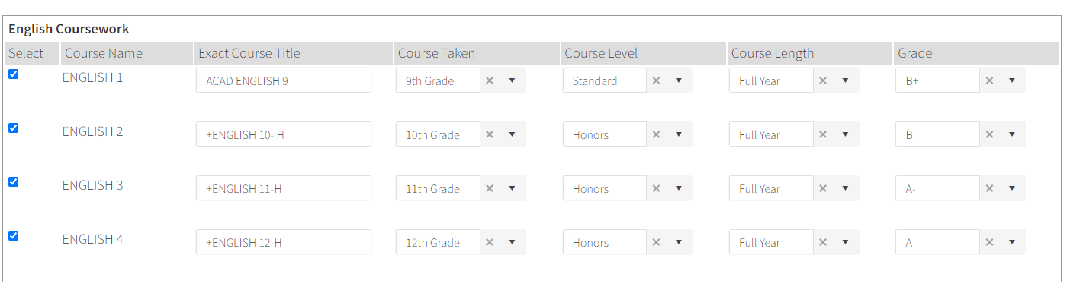
SRAR
(Self-Reported Academic Record)
Be sure to write courses exactly as they appear on your transcript!

Slide 29

Step 4:
Request Letters of Recommendation

Slide 30
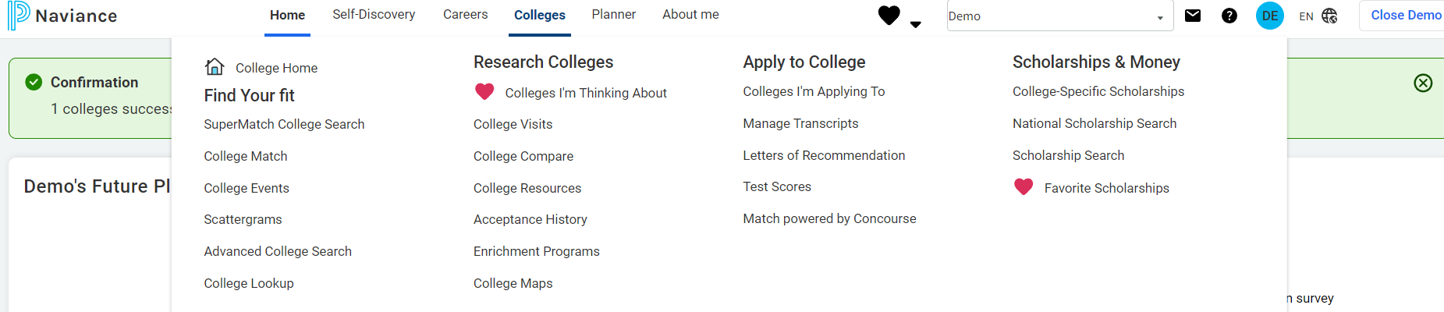
Go to Colleges Tab
Under “Apply to College,” select Letters of Recommendation

Slide 31
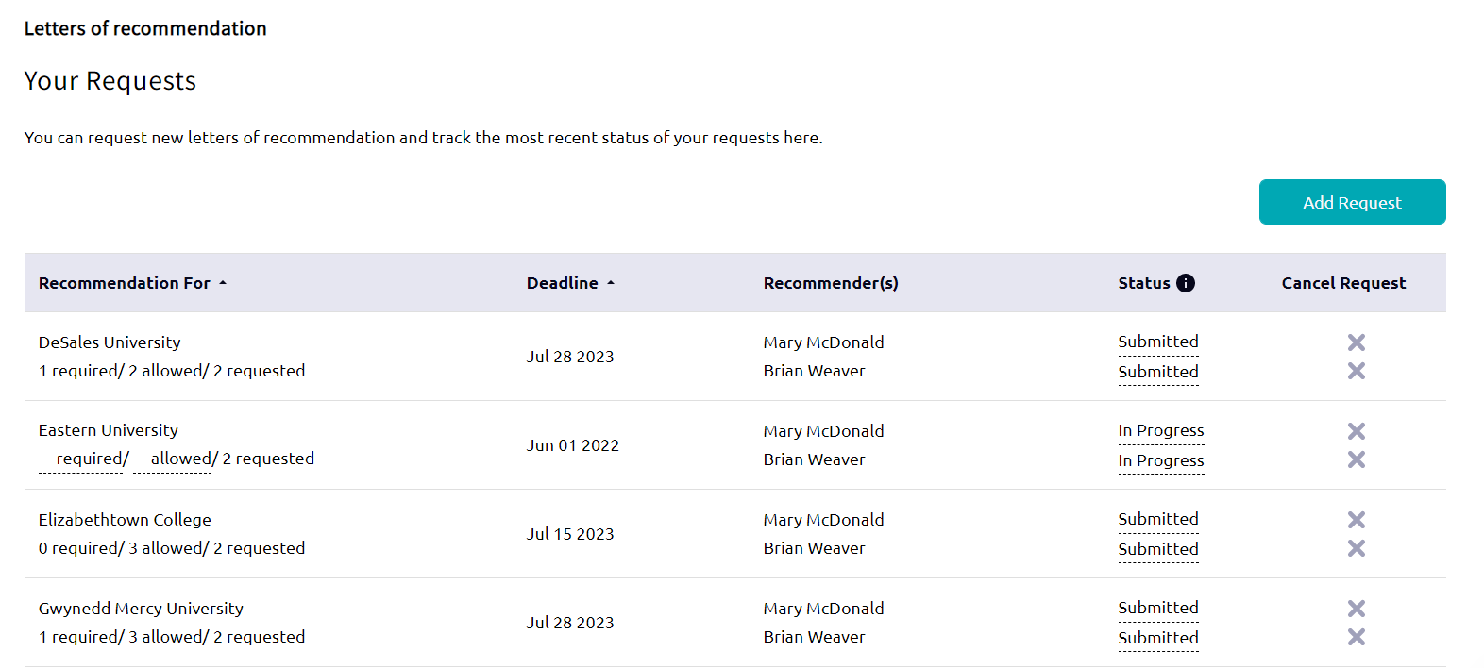
Select
“ADD REQUEST”

Slide 32
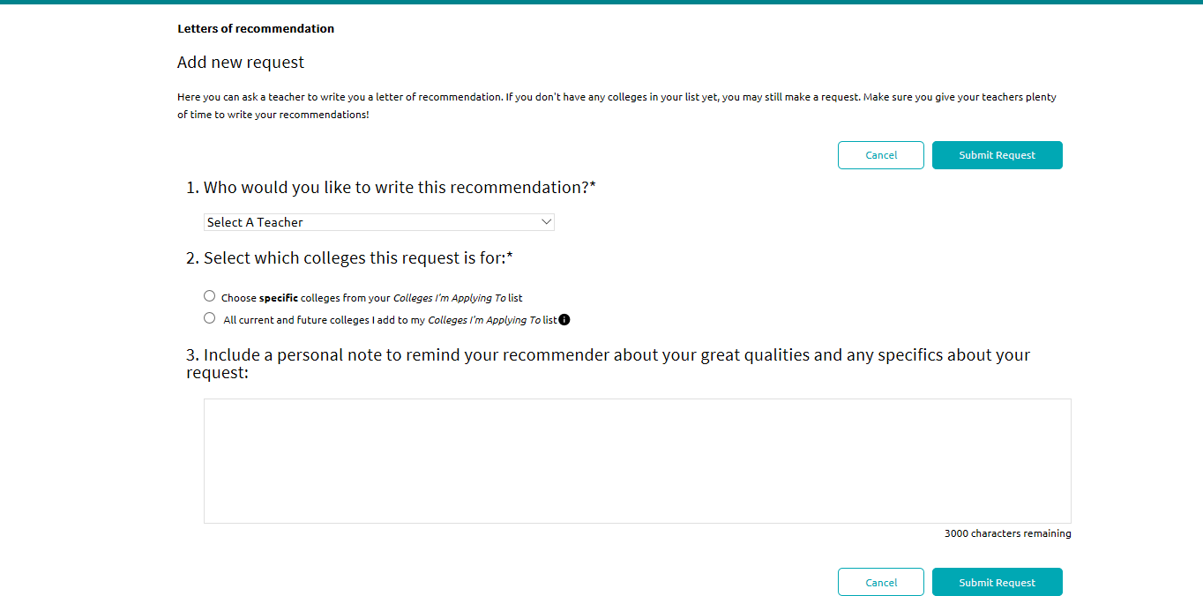

Slide 34
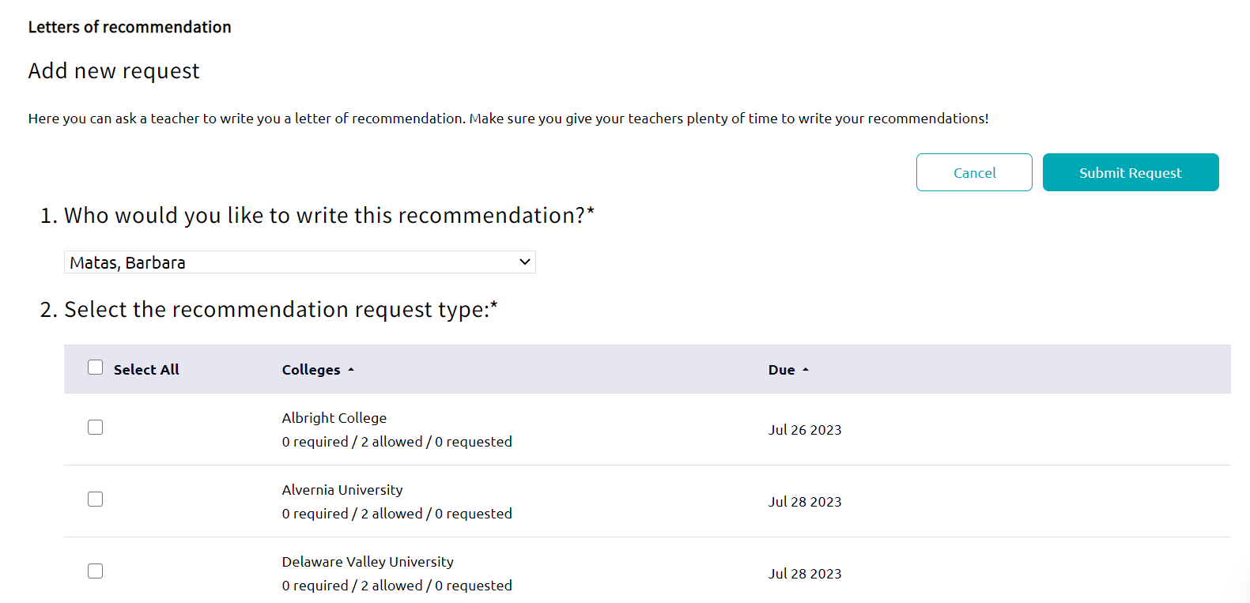

Slide 35
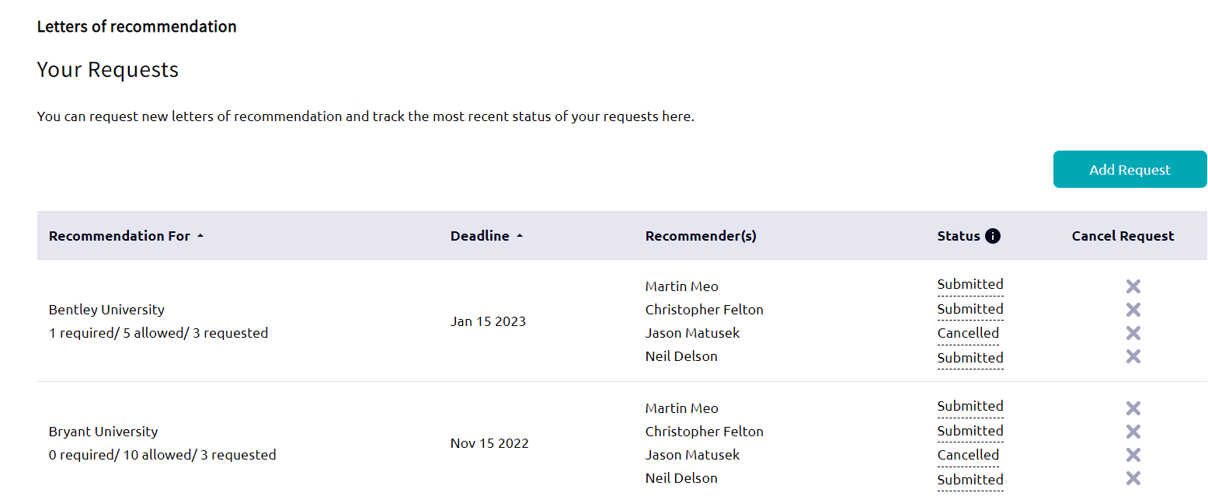
You should see either “Requested”, “In Progress” or “Submitted”.
If you see “Cancelled” status, that means the teacher did not accept your request. Contact that teacher ASAP!

Slide 36
STEP 5:
Send SAT/ACT Scores *if Required*
If colleges want “Official Scores,” you must send scores from College Board or ACT directly.
We do not have access to your College Board accounts. If you lost/forgot your login info, you must call College Board.
Most colleges will Super-Score (combine highest Math and English).
Penn State takes the best “sitting,” and does not SuperScore across multiple tests.

Slide 37

A Note about SAT/ACT Scores:
SAT/ACT Score reports contains scores from all prior testing sessions. Colleges prefer that you send all scores.
If you plan to take the SAT/ACT this fall, indicate the future exam date on your application.
  You may submit your finalized application prior to that date, and the college will wait to receive those scores before reviewing your file.
Note: All application materials must be received by the app deadline, so plan exam dates accordingly.
  Have a November 1st deadline? The Oct SAT Scores will be sent in time for that deadline.

Slide 38
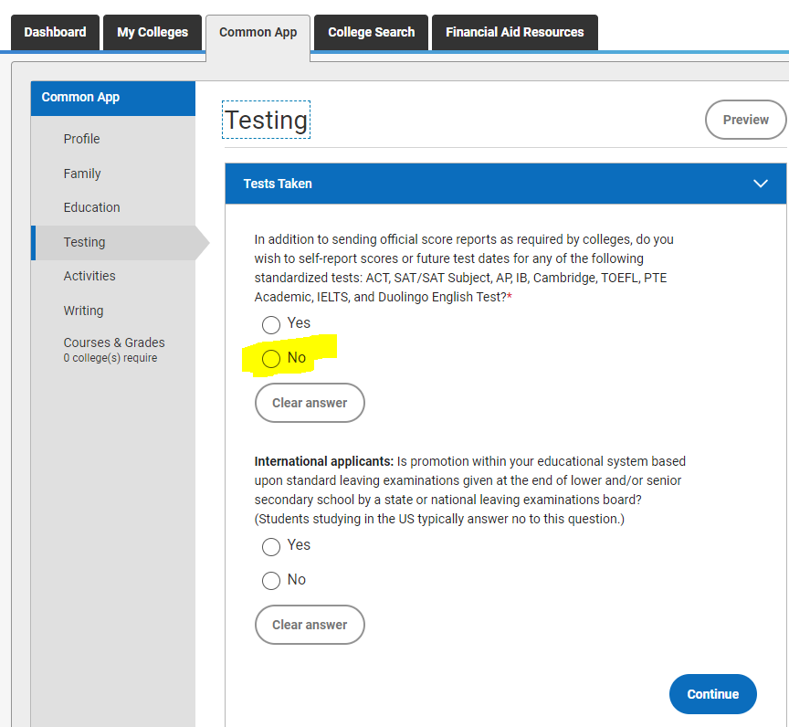
Applying Test Optional?
If you’re applying Test-Optional to ANY school:
Indicate you are applying Test Optional on the Common App.
DO NOT self-report SAT/ACT scores through your Common App, or these scores will be seen by all schools you apply to.

Slide 39
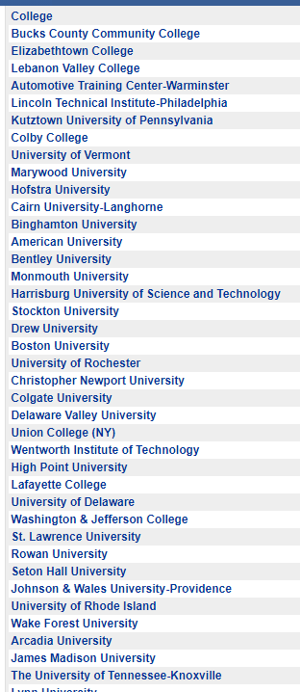
Fall College Visits at CB West
Over 200 colleges come to West during the fall.
Students sign up for these visits in Naviance.
Visits begin September 5th.
New colleges are added daily!
This is an opportunity to learn more about a college and make a personal connection with the Admissions Counselors!
Just a few. . .

Slide 40

NCAA / Eligibility
Prospective Division I and II athletes must register with the NCAA Clearinghouse at www.eligibilitycenter.org.
Work with your coach or counselor to make sure you meet the academic requirements (courses, GPA and SAT’s) for Division I or II.
Students should have registered by now. If not, then register immediately, and be sure to request that your transcript is sent to NCAA electronically.

Slide 41
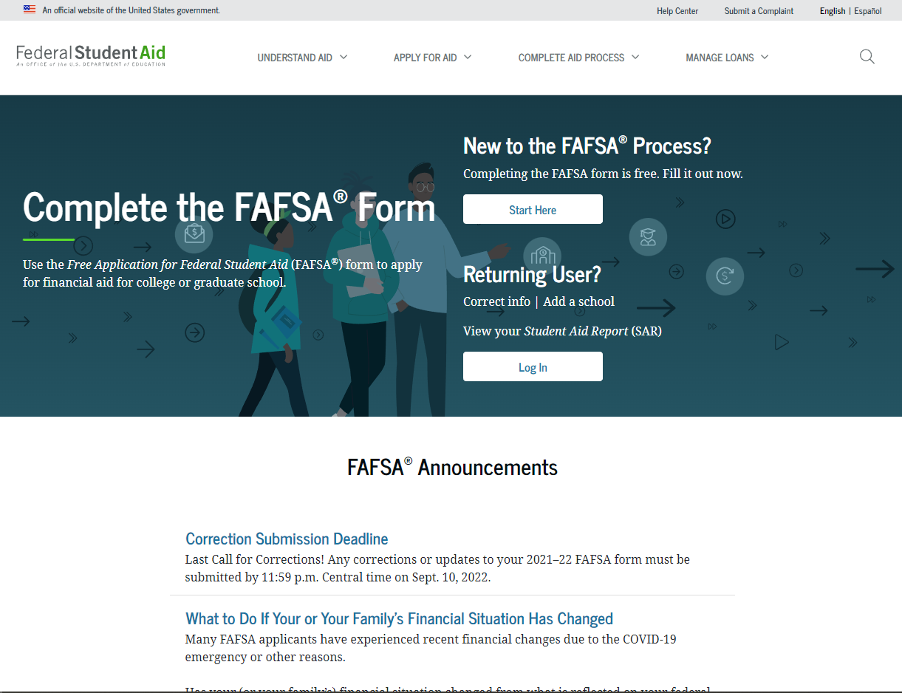
Completing the FAFSA (FAFSA.GOV) – Opens December 1st
Free Application for Federal Student Aid

Slide 42

CSS Profile – Opens October 2024
This is an additional step for certain schools found on the College Board Website.
In-depth look into your finances.
Only complete if required by the college.
Fee required.

Slide 43

Financial Aid Tips:
Every college website has a Net Price Calculator.
Scholarship searches can start in fall.
  Naviance
    Local Scholarships
  Employers
  Service Organizations
  Do NOT pay for a scholarship search!
Scholarship Websites:
Studentaid.ed.gov
Fastweb.com
Finaid.org
Collegeboard.com/bigfuture
Scholarshipmonkey.com
Check Financial Aid and/or Scholarship Information Webpages on Student Services site.

Slide 44

To Briefly Sum Up:

Slide 45
Here’s what Counselors send. . .
The Student Services Office will send the following to your colleges:
Your transcript
Secondary School Report form (we have these forms online - you don’t need to bring us any forms).
Our School Profile, which provides data about our school and district.
A copy of your senior schedule (if you make any changes to your schedule for senior year after it’s sent, you are responsible for reporting that to your colleges).
Note: We do NOT send teacher letters of rec. They upload and send their letters separately to the colleges you designate when you make your request.
A counselor recommendation if required;

Slide 46
Students:
Here’s what you do. . . .
Go to Website for all instructions /
refer to College Packet for step-by-step guide.
Fill out applications.
If Common App, complete the FERPA Waiver, and Match Naviance and the Common App.
Request Teacher letter(s) of recommendation through Naviance.
Request Transcripts through Naviance.
Complete and SUBMIT the Transcript Authorization to the Student Services Office.
Send official test scores, if required, from testing agency.
Confirm with teacher in-person.
Complete Counselor Rec Survey for 2025.

Slide 47
Your School Counselor is here to help!
Keep these things in mind
☺
Your counselor is available by appointment (come by the SSO).
Review the “how-to” step-by-step guides before asking how to send transcripts.
Please do not email your counselor in the evening and expect an immediate reply.
Writing a thorough Counselor Recommendation takes time. Be sure to request a rec and complete the survey well in advance of app deadlines!

Slide 48

3497: Applications processed last year
2731: Transcripts sent last year
6: Counselors
Your patience, kindness, and ownership of your own college application process is very much appreciated!

Slide 49


Any QUESTIONS? (Besides a million??)
Best of luck with this process.
You got this!

